Slide 1
Superconducting quantum computer design
A QHardware Tutorial Series
Part-4

Slide 2
Topics covered
Superconducting Qubits- Transmon
Circuit Quantum Electrodynamics (cQED) Architecture
Qubit Manipulation and Measurement
Qubit Characterization
Quantum Circuits and Universal Gates

Slide 3
Basic requirements to build quantum processor
Two level quantum systems
Creating arbitrary states
Measuring quantum states
Couple multiple qubits
Error correction (advanced feature)

Slide 4
Advantage of superconducting qc
Easy to manipulate
Long lifetimes
Strong couplings
Scalability

Slide 5
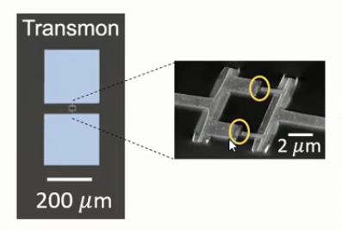
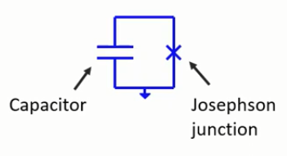
Transmon qubit
A transmon is a type of superconducting charge qubit that was designed to have reduced sensitivity to charge noise. The transmon is a Josephson junction and capacitor in parallel. Originally, transmons were differential circuits, i.e. two transmons on the same chip were not galvanically connected in any way.
A Josephson junction is a quantum mechanical device which is made of two superconducting electrodes separated by a barrier (thin insulating tunnel barrier, normal metal, semiconductor, ferromagnet, etc.)

Slide 6
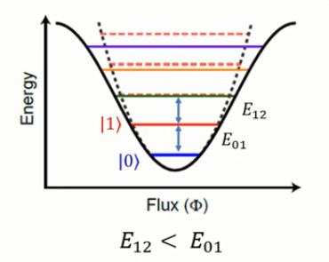

Transmon: anharmonic oscillator
Hamiltonian of a transmon circuit is defined as:
For quantum computation, we assume ground state as 0 and first state as 1.
It’s an effective two level system
An oscillator that is not oscillating in harmonic motion is known as an anharmonic oscillator where the system can be approximated to a harmonic oscillator and the anharmonicity can be calculated using perturbation theory. If the anharmonicity is large, then other numerical techniques have to be used.

Slide 7
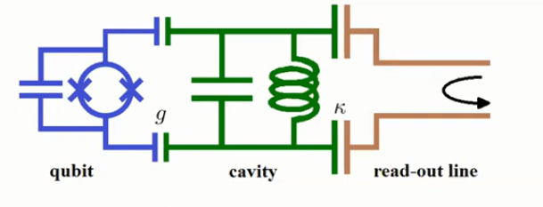
Circuit qed architecture
Circuit quantum electrodynamics (circuit QED) provides a means of studying the fundamental interaction between light and matter (quantum optics).

Slide 8
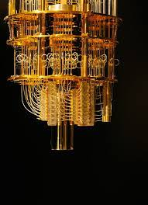
Dilution refrigerator
A ³He/⁴He dilution refrigerator is a cryogenic device that provides continuous cooling to temperatures as low as 2 mK, with no moving parts in the low-temperature region. The cooling power is provided by the heat of mixing of the Helium-3 and Helium-4 isotopes.

Slide 9
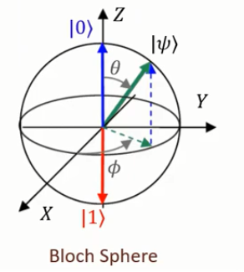
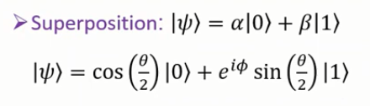
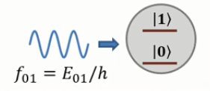
Bloch sphere and rabi oscillation
On the Bloch sphere, applying a light pulse to the qubit corresponds to a rotation around an axis in the equatorial plane. In quantum mechanics and computing, the Bloch sphere is a geometrical representation of the pure state space of a two-level quantum mechanical system (qubit).
The Rabi oscillation in a coherent field with a finite photon number thus collapses after a time Tcollapse whose order of magnitude is the Rabi oscillation period in vacuum.

Slide 10
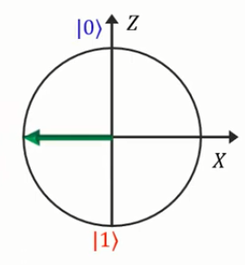
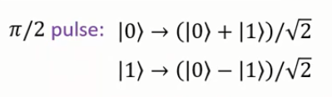
Single qubit gate
Single qubit gates correspond to rotations of a spin about some axis. The simplest gates are rotations about axes in the xy-plane, as these can be implemented using resonant RF pulses. The flip angle of the pulse (the angle through which the spin is rotated) depends on the length and the power of the RF pulse, while the phase angle of the pulse (and hence the azimuthal angle made by the rotation axis in the xy-plane) can be controlled by choosing the initial phase angle of the RF.
For example, for pi/2 pulse, qubit angle rotation is happed

Slide 11

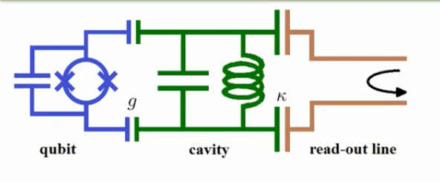

Qubit measurement
The Jaynes–Cummings model (sometimes abbreviated JCM) is a theoretical model in quantum optics. It describes the system of a two-level atom interacting with a quantized mode of an optical cavity (or a bosonic field), with or without the presence of light (in the form of a bath of electromagnetic radiation that can cause spontaneous emission and absorption).

Slide 12
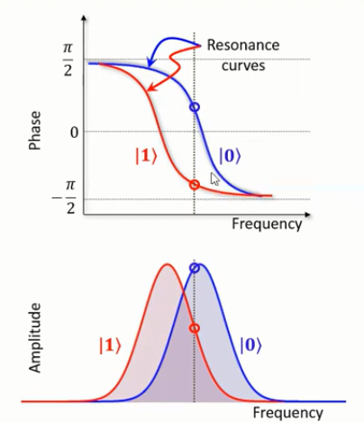
Qubit measurement
To know the situation of qubit whether in ground state or excited state.

Slide 13
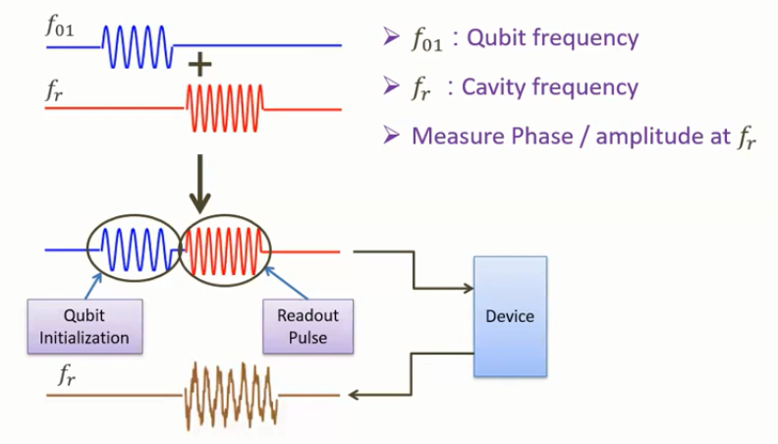
Qubit measurement protocol

Slide 14
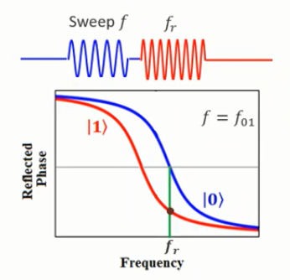
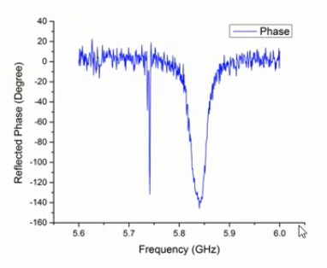
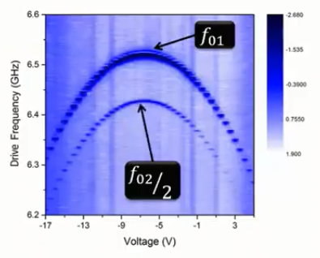
Qubit spectroscopy
Tow tones: one at cavity resonance while sweeping another
Measure phase of the reflected signal at readout frequency
Change bias flux and repeat

Slide 15
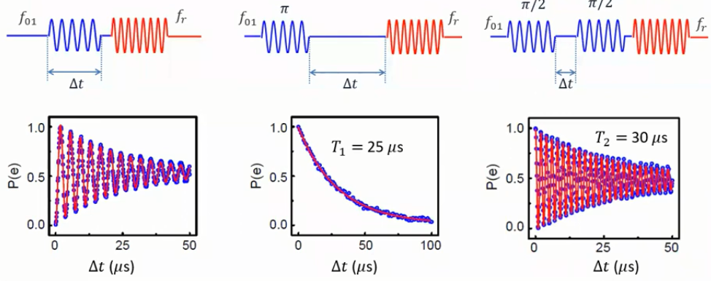
Qubit characterization
Rabi oscillation Qubit relaxation Qubit dephasing

Slide 16
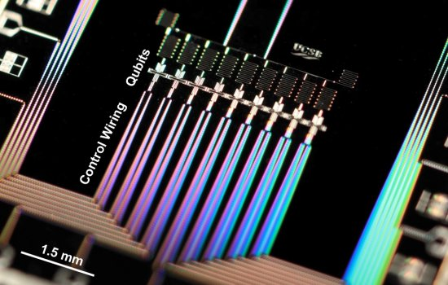
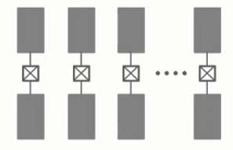
Multi qubit system
Two types of multi-qubit architectures are used
Google 9-qubit chip architecture

Slide 17
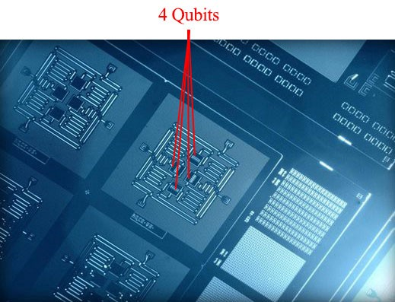
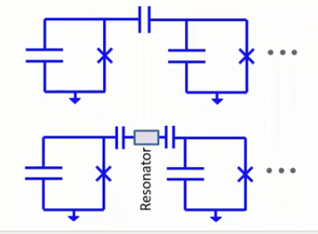
Multi qubit
IBM 4-qubit chip architecture

Slide 18
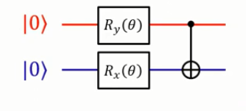

Universal gates and quantum circuits
Single qubit rotation and CNOT gate from a universal set
CNOT gate: flip qubit 2 only if qubit 1 is in |1> state

Slide 19
Current superconducting quantum processors
Sycamore is a quantum processor created by Google's Artificial Intelligence division. It has 53 qubits.
IBM Eagle is a 127-qubit quantum processor. IBM claims that it can not be simulated by any classical computer. It is two times bigger than China's Jiuzhang 2. It was revealed on the 16th of November 2021 and is claimed to be the most powerful quantum processor ever made.

Slide 20
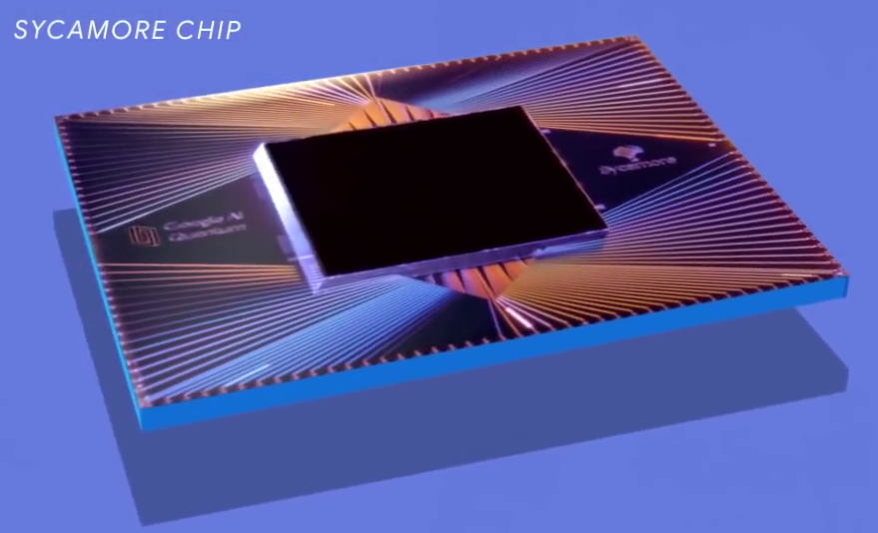
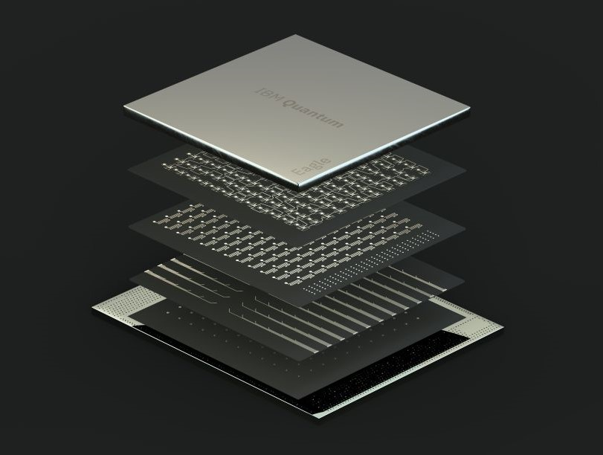
Google sycamore and ibm eagle processor

Slide 21
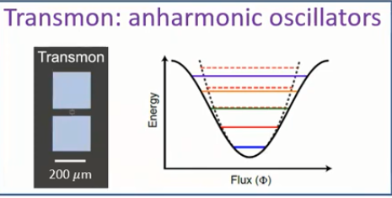
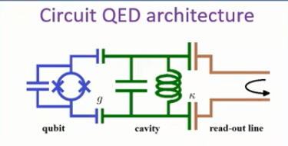
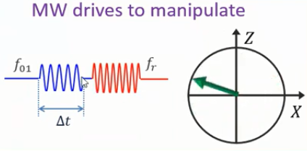
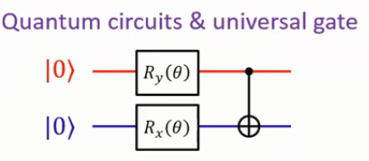
Summary

Slide 22
References
1. Qiskit Metal Documentation- https://qiskit.org/documentation/metal/
2. Qiskit Textbook- https://qiskit.org/learn/
3. A Quantum Engineer's Guide to Superconducting Qubits (https://arxiv.org/abs/1904.06560)
4. Quantum Computation and Quantum Information by Michael A. Nielsen and Isaac Chuang
5. Principles of Superconducting Quantum Computers by Daniel D. Stancil and Gregory T. Byrd
6. National Academies of Sciences, Engineering, and Medicine. 2019. Quantum Computing: Progress and Prospects. Washington, DC: The National Academies Press. https://doi.org/10.17226/25196.

